Slide 1
DIGITAL DESIGN USING HDL
MODULE 2

Slide 2
MODULE 1 SYLLABUS
Gate-level minimization and Introduction to Verilog HDL
Introduction to Boolean Functions,
K Map-Method: 2-Variable, 3-Variable, 4-Variable, Five Variable map,
POS Simplification,
Don’t Care Conditions,
NAND NOR Implementation,
Other Two Level Implementations,
Quine-Mc Cluskey Minimization Methods;
HDL Flow, Module Declaration,
Gate Delays,
Boolean Expression Assignment,
User Defined Primitives

Slide 3
MODULE 2 SYLLABUS
Combinational Logic Circuit
Design Procedure,
Binary Adder-Subtractor,
Decimal Adder,
Binary Multiplier,
Magnitude Comparator,
Decoders and Encoders,
Multiplexers and Demultiplexers;
Verilog Models of CLC: Gate Level Modeling,
Three State Gates,
Data Flow modeling,
Behavioral Modeling,
Test Bench

Slide 4
Design Procedure
1. From the specifications of the circuit, determine the required number of inputs and outputs and assign a symbol to each.
2. Derive the truth table that defines the required relationship between inputs and outputs.
3. Obtain the simplified Boolean functions for each output as a function of the input variables.
4. Draw the logic diagram and verify the correctness of the design (manually or by simulation).

Slide 5
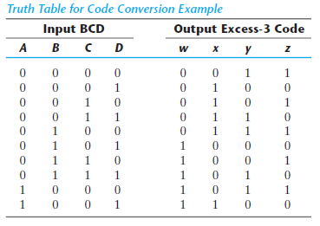
Code Conversion Example
Truth Table

Slide 6
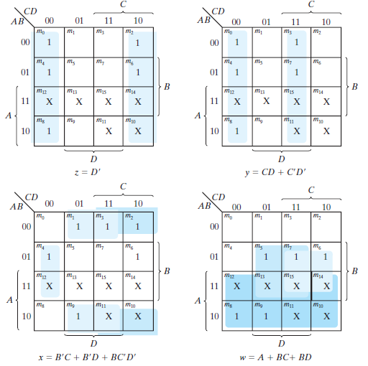
BCD – EXCESS3 CODE CONVERSION K MAPS

Slide 7
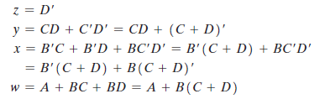
Boolean Expression

Slide 8
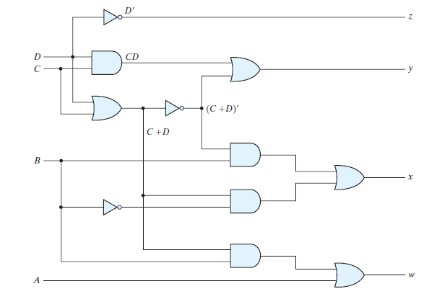
LOGIC DIAGRAM

Slide 9
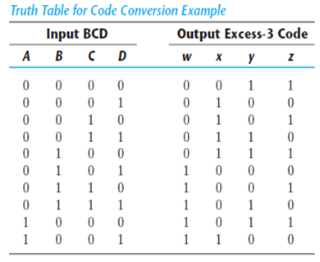
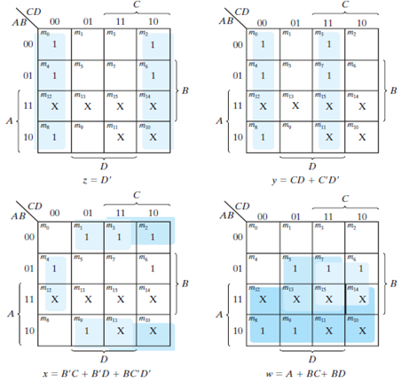
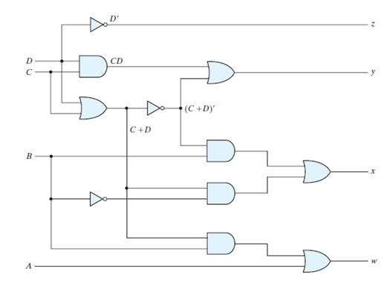
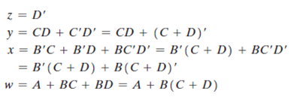
(a) TRUTH TABLE
(b) Simplification using K-Map
(d) Logic Diagram
(C) Boolean Expressions

Slide 10
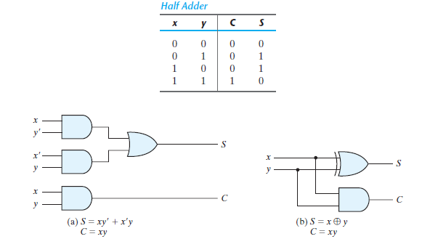
BINARY ADDER - SUBTRACTOR
HALF ADDER

Slide 11
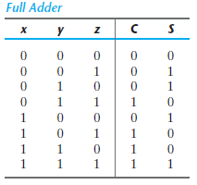
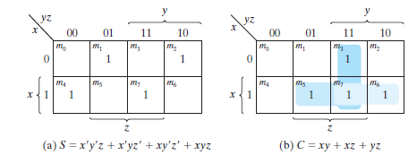
BINARY ADDER - SUBTRACTOR
FULL ADDER

Slide 12
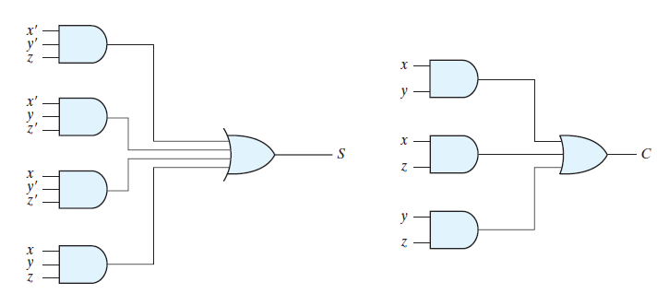

Slide 13
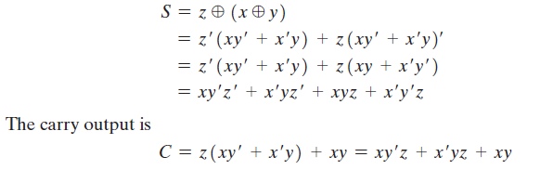

Slide 14
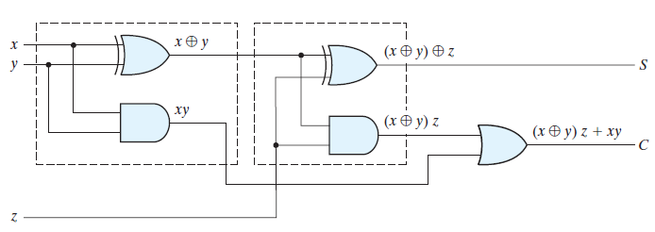
HALF ADDER 1
HALF ADDER 2

Slide 15
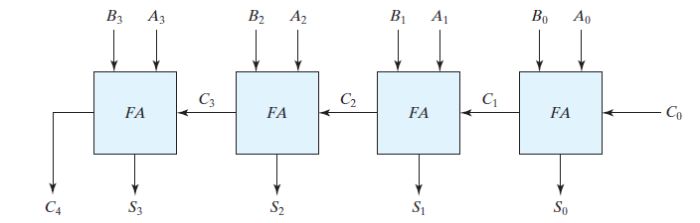
BINARY ADDER
A binary adder is a digital circuit that produces the arithmetic sum of two binary numbers.
It can be constructed with full adders connected in cascade, with the output carry from each full adder connected to the input carry of the next full adder in the chain.
4 BIT RIPPLE CARRY ADDER

Slide 16
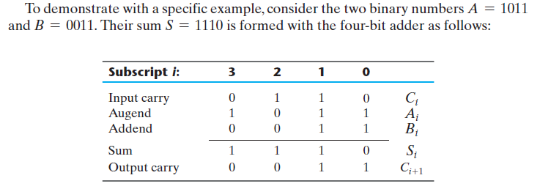
4 BIT RIPPLE CARRY ADDER

Slide 17
CARRY PROPAGATION
Since each bit of the sum output depends on the value of the input carry, the value of Si at any given stage in the adder will be in its steady-state final value only after the input carry to that stage has been propagated.
The carry propagation time is an important attribute of the adder because it limits the speed with which two numbers are added.
There are several techniques for reducing the carry propagation time in a parallel adder. The most widely used technique employs the principle of carry lookahead logic.

Slide 18
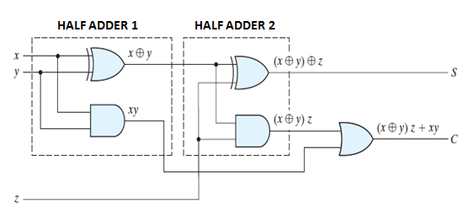
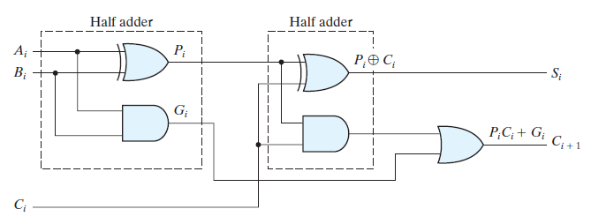
CARRY LOOKAHEAD GENERATION

Slide 19




Slide 20



We now write the Boolean functions for the carry outputs of each stage and substitute the value of each Ci from the previous equations:

Slide 21
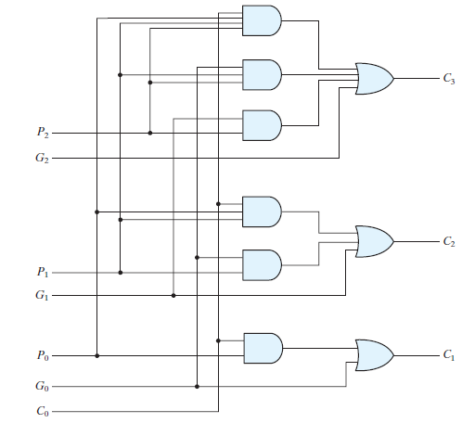
LOGIC DIAGRAM FOR CARRY LOOKAHEAD GENERATOR

Slide 22
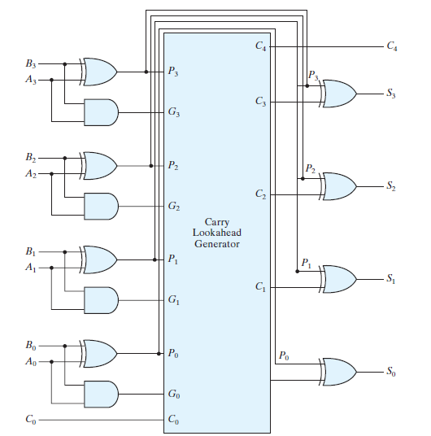
FOUR BIT CARRY LOOKAHEAD ADDER

Slide 23
BINARY - SUBTRACTOR
The subtraction A - B can be done by taking the 2’s complement of B and adding it to A .
The 2’s complement can be obtained by taking the 1’s complement and adding 1 to the least significant pair of bits.
The 1’s complement can be implemented with inverters, and a 1 can be added to the sum through the input carry.

Slide 24
OVERFLOW CONDITION
When two numbers with n digits each are added and the sum is a number occupying n + 1 digits, we say that an overflow occurred.
The detection of an overflow after the addition of two binary numbers depends on whether the numbers are considered to be signed or unsigned.
When two unsigned numbers are added, an overflow is detected from the end carry out of the most significant position.
In the case of signed numbers, two details are important: the leftmost bit always represents the sign, and negative numbers are in 2’s-complement form. When two signed numbers are added, the sign bit is treated as part of the number and the end carry does not indicate an overflow.

Slide 25
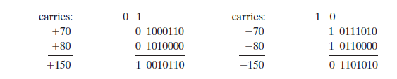
OVERFLOW CONDITION
An overflow cannot occur after an addition if one number is positive and the other is negative, since adding a positive number to a negative number produces a result whose magnitude is smaller than the larger of the two original numbers.
An overflow may occur if the two numbers added are both positive or both negative.

Slide 26
OVERFLOW CONDITION
Note that the eight-bit result that should have been positive has a negative sign bit (i.e., the eighth bit) and the eight-bit result that should have been negative has a positive sign bit.
If, however, the carry out of the sign bit position is taken as the sign bit of the result, then the nine-bit answer so obtained will be correct. But since the answer cannot be accommodated within eight bits, we say that an overflow has occurred.

Slide 27
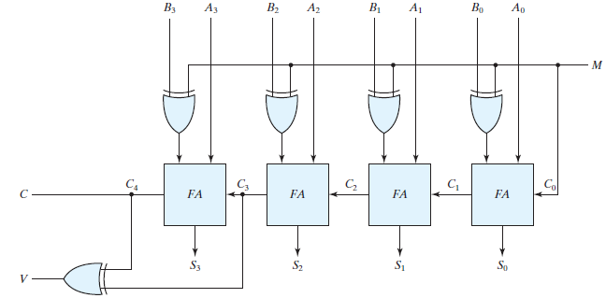
OVERFLOW CONDITION
An overflow condition can be detected by observing the carry into the sign bit position and the carry out of the sign bit position. If these two carries are not equal, an overflow has occurred.

Slide 28
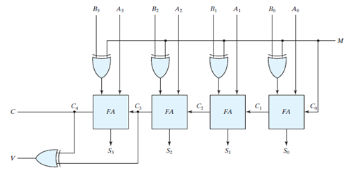
FOUR BIT ADDER – SUBTRACTOR WITH OVERFLOW DETECTION
The binary adder–subtractor circuit with outputs C and V is shown above. If the
two binary numbers are considered to be unsigned, then the C bit detects a carry after addition or a borrow after subtraction.
If the numbers are considered to be signed, then the V bit detects an overflow. If V = 0 after an addition or subtraction, then no overflow occurred and the n -bit result is correct.
If V = 1, then the result of the operation contains n + 1 bits, but only the rightmost n bits of the number fit in the space available, so an overflow has occurred. The (n + 1) th bit is the actual sign and has been shifted out of
position.

Slide 29
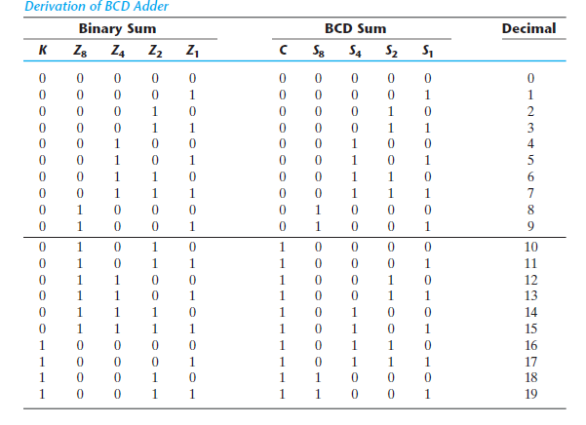

DECIMAL ADDER

Slide 30
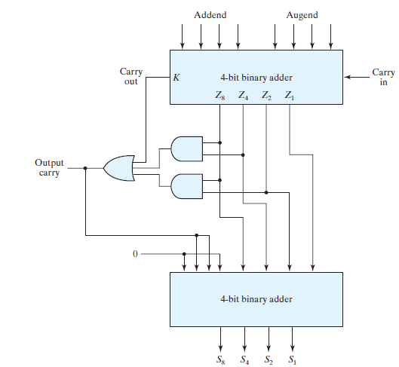
DECIMAL ADDER

Slide 31
BINARY MULTIPLIER
Multiplication of binary numbers is performed in the same way as multiplication of decimal numbers.
The multiplicand is multiplied by each bit of the multiplier, starting from the least significant bit. Each such multiplication forms a partial product.
Successive partial products are shifted one position to the left.
The final product is obtained from the sum of the partial products.

Slide 32
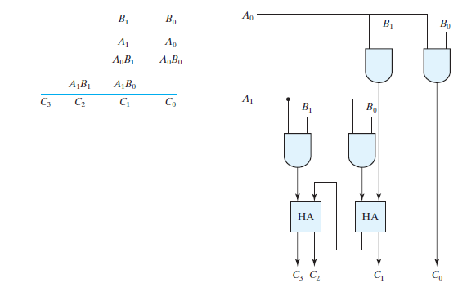
BINARY MULTIPLIER

Slide 33
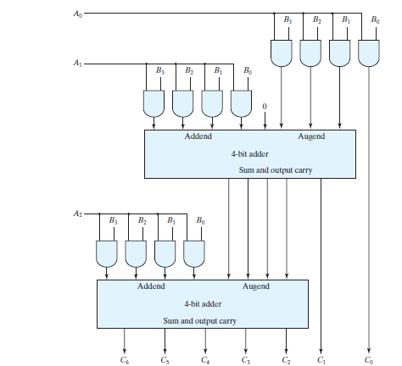
BINARY MULTIPLIER
B3B2B1B0 X A2A1A0
For J multiplier bits and K multiplicand bits,
we need (J * K) AND gates and (J – 1) K -bit adders to produce a product of (J + K)
bits.
K = 4 and J = 3

Slide 34
MAGNITUDE COMPARATOR
A magnitude comparator is a combinational circuit that compares two numbers A and B and determines their relative magnitudes.
The outcome of the comparison is specified by three binary variables that indicate whether A > B, A = B, or A < B.

Slide 35


MAGNITUDE COMPARATOR

Slide 36
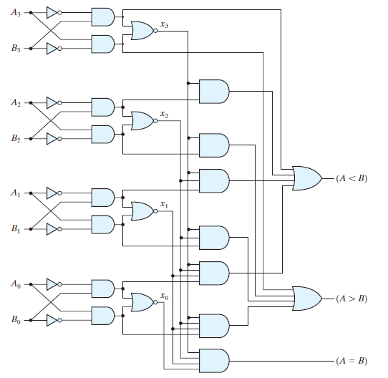
MAGNITUDE COMPARATOR

